Slide 1
Infotou Data Application
Juan Javier Luna - 2020

Slide 2
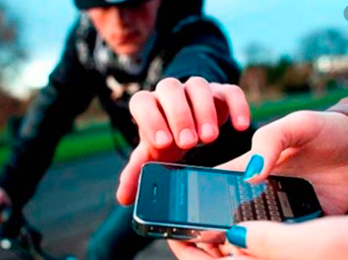
Business Problem
Many tourists over the globe have been affected by insecurity when visiting places on other cities, this due to the fact the tourist does not have information about the most common places where crimes are performed. According to this the tourism and the people affected annually loses a lot of many and time.
Infotou is a data application that deliveries the tourist all information regarding to venues and the security around them, this would help tourists to make good decisions and to have a better vacation around the global cities.

Slide 3

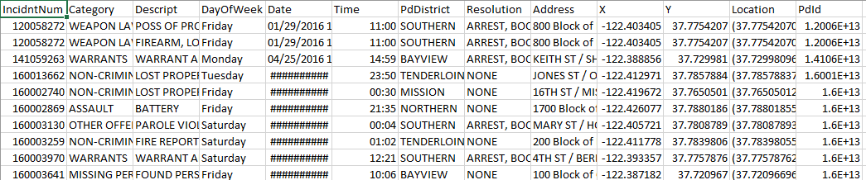
Data Source
Foursquare location data, in order to have all venues from the city of San Francisco
Data base of crimes in the city of San Francisco.

Slide 4
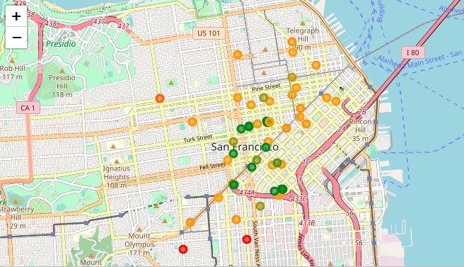
Results

